Slide 1
Welcome to Internet Banking Demo

Slide 2
Type www.unionbankofindiauk.co.uk (corporate website) in the address bar of your web browser Click on Internet Banking icon as shown below :

Slide 3
You will be directed to Internet Banking website www.unionbankonline.co.uk Check for the prefix https: before proceeding further

Slide 4
Click on Retail User Login if you are a retail user or Corporate User login if you have corporate Internet Banking facility

Slide 5
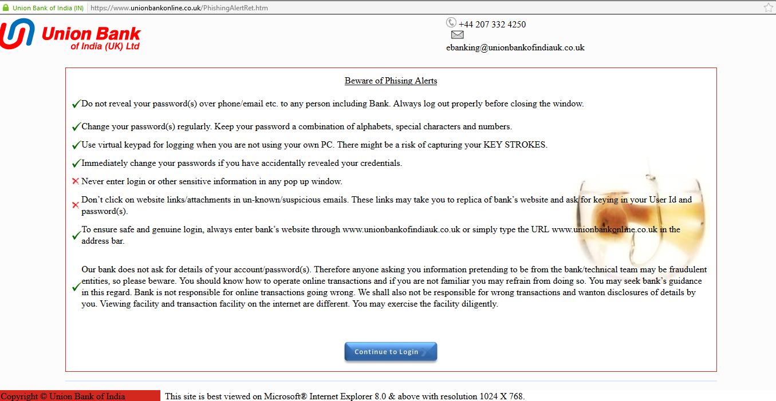
The next page is Phishing Alerts Page. Read the Do’s and Don’ts and then click on Continue to login.

Slide 6
This is the login page. First field is for User ID. Second field is CAPTCHA and has to be entered by the User. Then click on Log in.

Slide 8
Once you click on Log in :
You will receive One Time Password (OTP) on your registered mobile.
OTP is received every time during login and is a secondary authentication mode.
First item users are forced to change their login & transaction passwords.
Update Personal Assurance Message (PAM) – PAM appears every time you login and assures that the user is visiting original page.

Slide 9
Personal Assurance Message (PAM) is entered here

Slide 11
Successful Login : The user lands on the Dashboard. You can see the last login time and date. The Dashboard can be personalised and Widgets can be added or removed.

Slide 12
Accounts :
Account Summary : Displays the balance summary of all accounts
Operative Accounts : Has various sup-options to view and download statement
Contd..

Slide 13
Click on Operative Accounts
View mini Statement : Click here to see last one month’s transaction on screen
Transaction History : Click to see statement of accounts over a range of period.
You can also download the statement in the required formats available in the facility.

Slide 14
Transactions Initiate Funds Transfer – Within Bank Initiate Payment – Outside bank within UK

Slide 15
Addition of Counterparty/Beneficiary : Go to Transactions>Manage Counterparty>Add Counterparty The fields marked with red asterisk are compulsory Network Id refers to the type of payment like BACS, FPS for payment outside bank within UK

Slide 16
Initiate Funds Transfer : Fill in the mandatory fields marked with red asterisk
Select Counterparty : If you have already added a new counterparty
Click on Personal Payee and all counterparties added will be shown under dropdown. Select the counterparty for fund transfer to third party beneficiary within bank.
Select Counterparty : Click on My accounts in Home Bank to transfer to your own accounts within bank.

Slide 17
To proceed for Payment : Go to transactions>Select Personal Payee (if counterparty is already added) or proceed By selecting Adhoc Personal Payee – fields marked with red asterisk are compulsory

Slide 18
Change Password : Go to My Profile> Click on drop down > Select Change Passwords

Slide 19
View/Update Phrase : Go to My Profile : Click on dropdown Select view Image/Phrase Details

Slide 20
General Services : For sending mails to Relationship Manager and submitting requests

Slide 21
General Services : Facility for sending mail internally to Relationship Manager Service Request available in offline mode only Go to General Services>Click Mails>click dropdown and select Go to General Services>Click Service Request

Slide 22
For further any assistance or clarification please feel free to contact us on
020 7332 4250 or send an e-mail to ebanking@unionbankofindiauk.co.uk

